Slide 1
Learning
Decision Trees

Slide 2
Decision Tree Classification Algorithm
Decision Tree is a Supervised learning technique that can be used for both classification and Regression problems, but mostly it is preferred for solving Classification problems.
It is a tree-structured classifier, where internal nodes represent the features of a dataset, branches represent the decision rules and each leaf node represents the outcome.
In a Decision tree, there are two nodes, which are the Decision Node and Leaf Node.
Decision nodes are used to make any decision and have multiple branches, whereas Leaf nodes are the output of those decisions and do not contain any further branches.
The decisions or the test are performed on the basis of features of the given dataset.

Slide 3
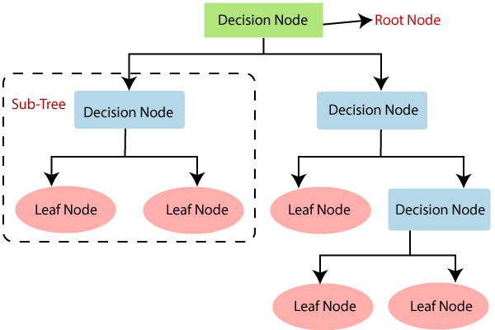
It is called a decision tree because, similar to a tree, it starts with the root node, which expands on further branches and constructs a tree-like structure.
In order to build a tree, we use the CART algorithm, which stands for Classification and Regression Tree algorithm.

Slide 4
Why use Decision Trees?
There are various algorithms in Machine learning, so choosing the best algorithm for the given dataset and problem is the main point to remember while creating a machine learning model. Below are the two reasons for using the Decision tree:
Decision Trees usually mimic human thinking ability while making a decision, so it is easy to understand.
The logic behind the decision tree can be easily understood because it shows a tree-like structure.

Slide 5
Decision Tree Terminologies
Root Node: Root node is from where the decision tree starts. It represents the entire dataset, which further gets divided into two or more homogeneous sets.
Leaf Node: Leaf nodes are the final output node, and the tree cannot be segregated further after getting a leaf node.
Splitting: Splitting is the process of dividing the decision node/root node into sub-nodes according to the given conditions.
Branch/Sub Tree: A tree formed by splitting the tree.
Pruning: Pruning is the process of removing the unwanted branches from the tree.
Parent/Child node: The root node of the tree is called the parent node, and other nodes are called the child nodes.

Slide 6
How does the Decision Tree algorithm Work?
Step-1: Begin the tree with the root node, says S, which contains the complete dataset.
Step-2: Find the best attribute in the dataset using Attribute Selection Measure (ASM).
Step-3: Divide the S into subsets that contains possible values for the best attributes.
Step-4: Generate the decision tree node, which contains the best attribute.
Step-5: Recursively make new decision trees using the subsets of the dataset created in step -3.
Continue this process until a stage is reached where you cannot further classify the nodes and called the final node as a leaf node.

Slide 7
Attribute Selection Measures
While implementing a Decision tree, the main issue arises that how to select the best attribute for the root node and for sub-nodes.
So, to solve such problems there is a technique which is called as Attribute selection measure or ASM.
By this measurement, we can easily select the best attribute for the nodes of the tree.
There are two popular techniques for ASM, which are:
Information Gain
Entropy

Slide 8
Information Gain:
Information gain is the measurement of changes in entropy after the segmentation of a dataset based on an attribute.
It calculates how much information a feature provides us about a class.
According to the value of information gain, we split the node and build the decision tree.
A decision tree algorithm always tries to maximize the value of information gain, and a node/attribute having the highest information gain is split first.
Information Gain= Entropy(S)-
(Weighted Avg) *Entropy(each feature)

Slide 9
Entropy: Entropy is a metric to measure the impurity in a given attribute. It specifies randomness in data.
Entropy can be calculated as:
Entropy(s)= -P(yes)log2 P(yes)- P(no) log2 P(no)
Where,
S= Total number of samples
P(yes)= probability of yes
P(no)= probability of no

Slide 10
Advantages of the Decision Tree
It is simple to understand as it follows the same process which a human follow while making any decision in real-life.
It can be very useful for solving decision-related problems.
It helps to think about all the possible outcomes for a problem.
There is less requirement of data cleaning compared to other algorithms.

Slide 11
Disadvantages of the Decision Tree
The decision tree contains lots of layers, which makes it complex.
It may have an overfitting issue, which can be resolved using the Random Forest algorithm.
For more class labels, the computational complexity of the decision tree may increase.
ID3 Algorithm
Although there are various decision tree learning algorithms, we will explore the Iterative Dichotomiser 3 or commonly known as ID3. ID3 was invented by Ross Quinlan.

Slide 12
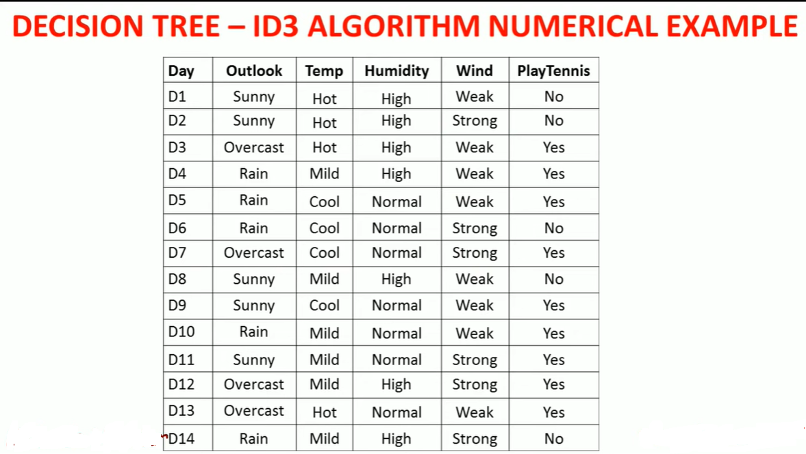

Slide 13
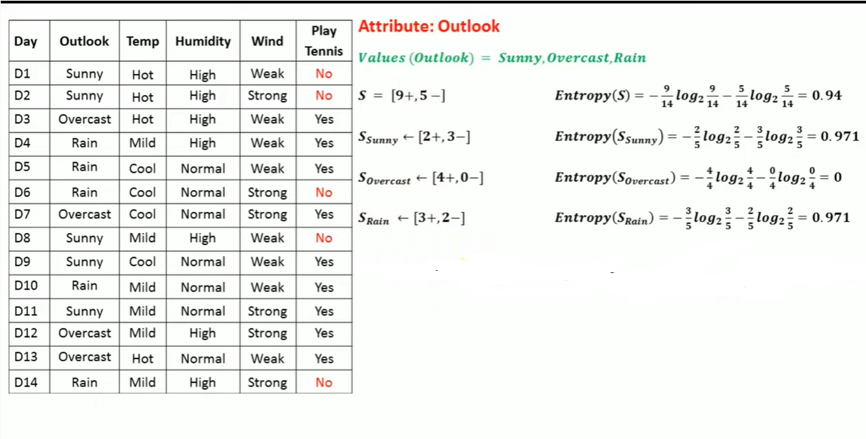

Slide 14
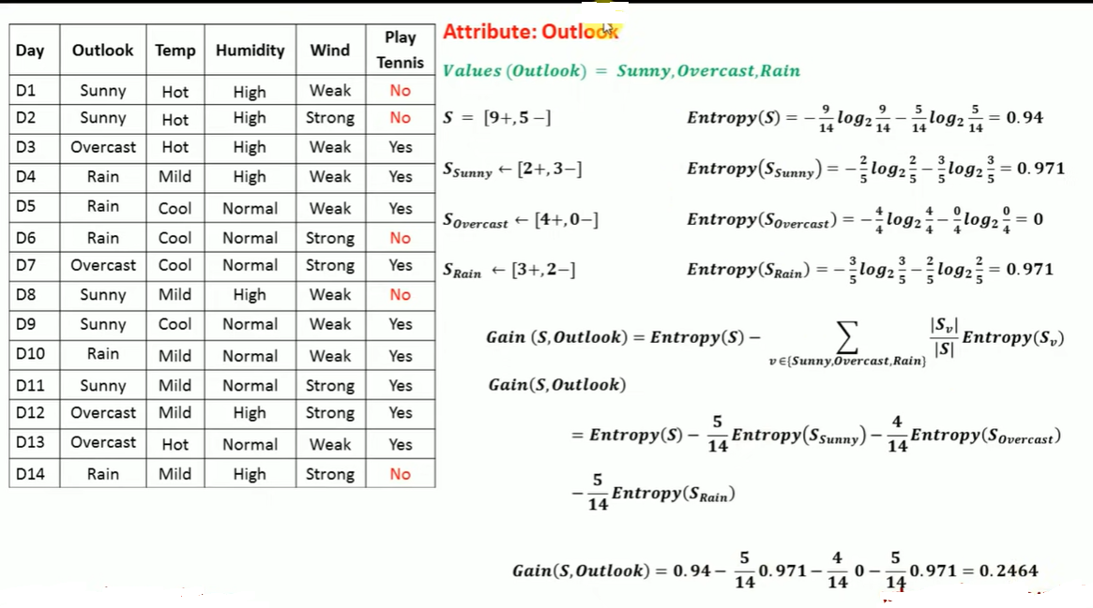

Slide 15
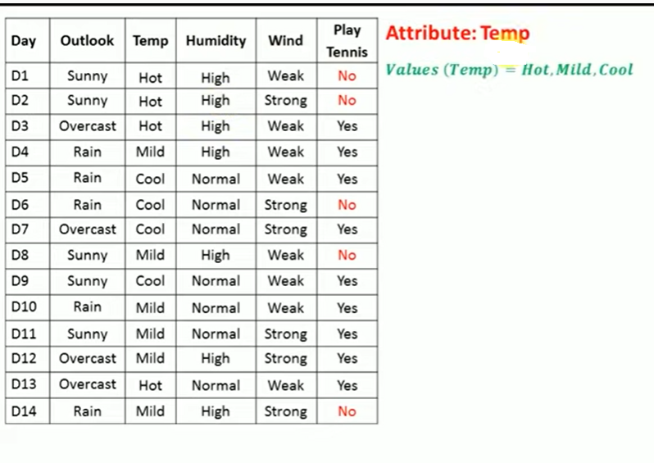

Slide 16
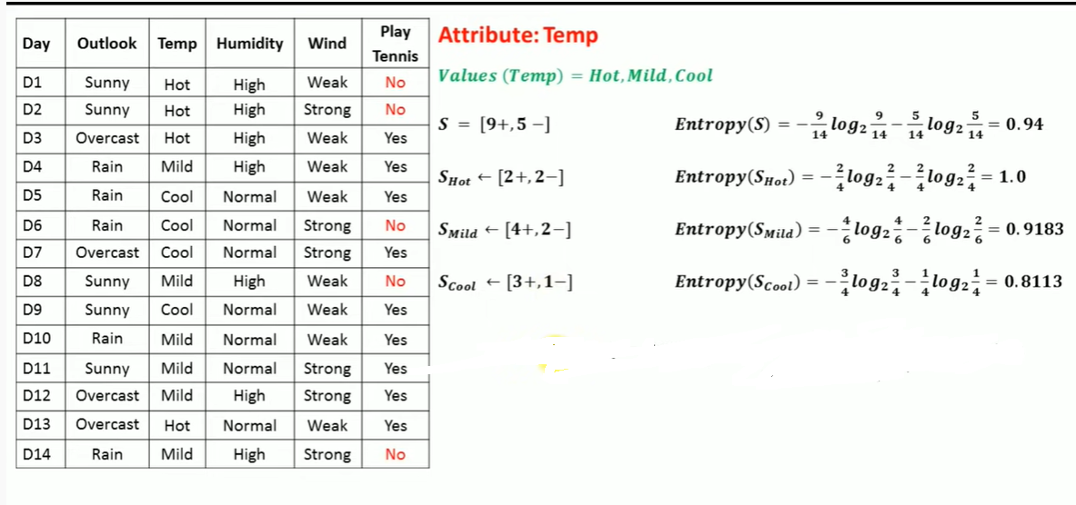

Slide 17
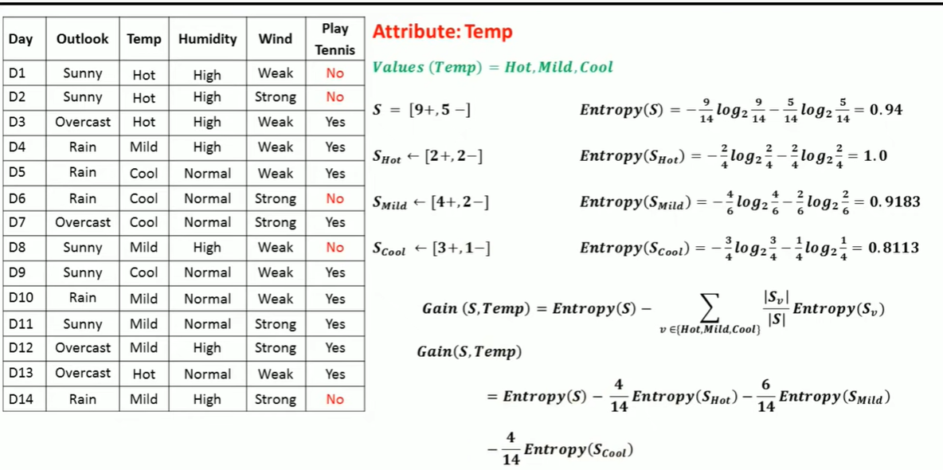
Gain(S, Temp)=0.0289

Slide 18
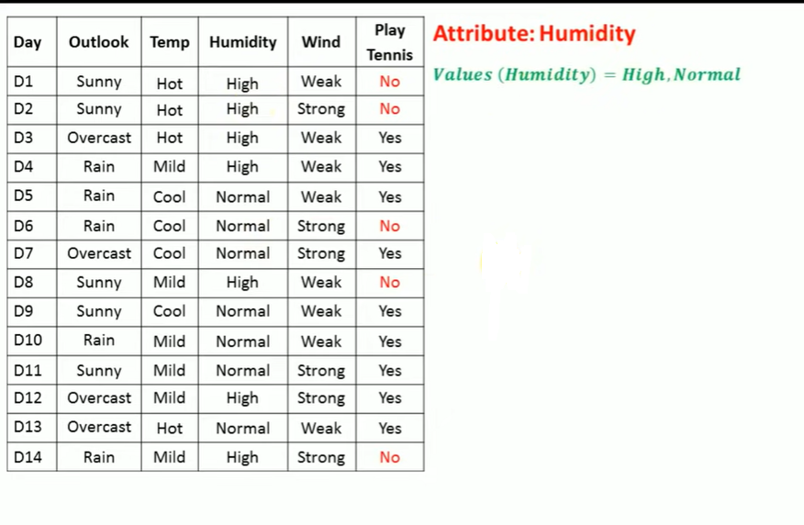

Slide 19
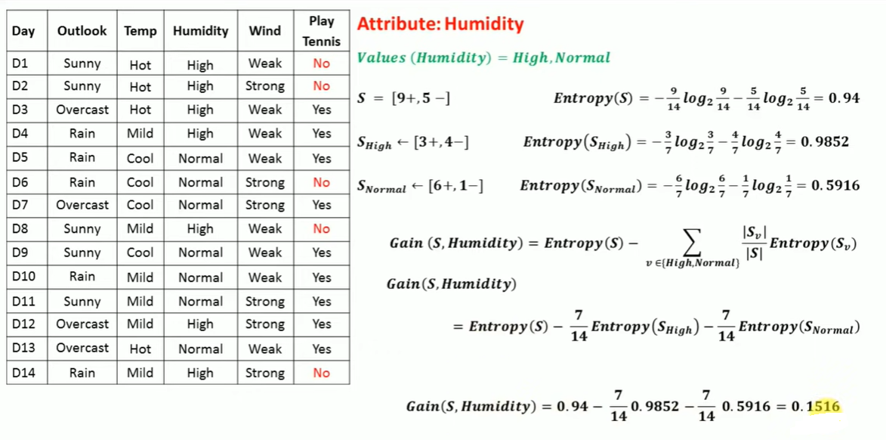

Slide 20
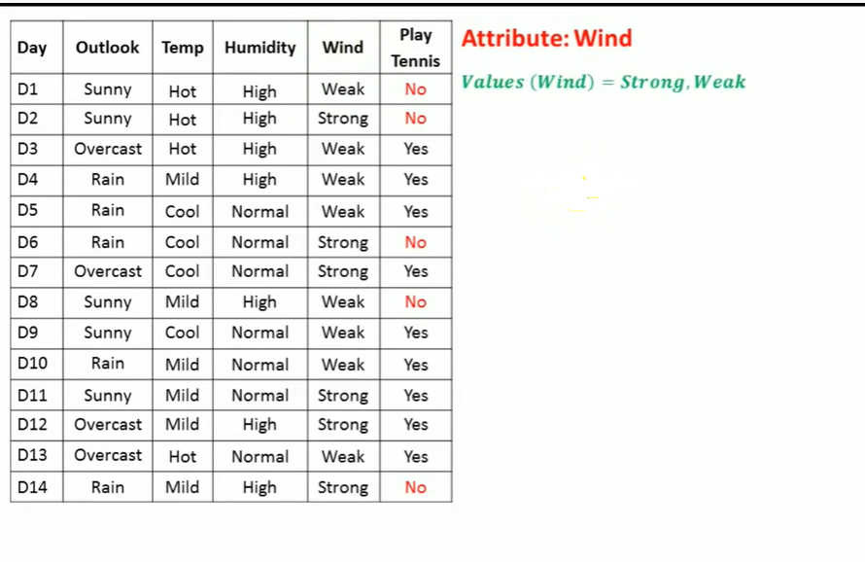

Slide 21
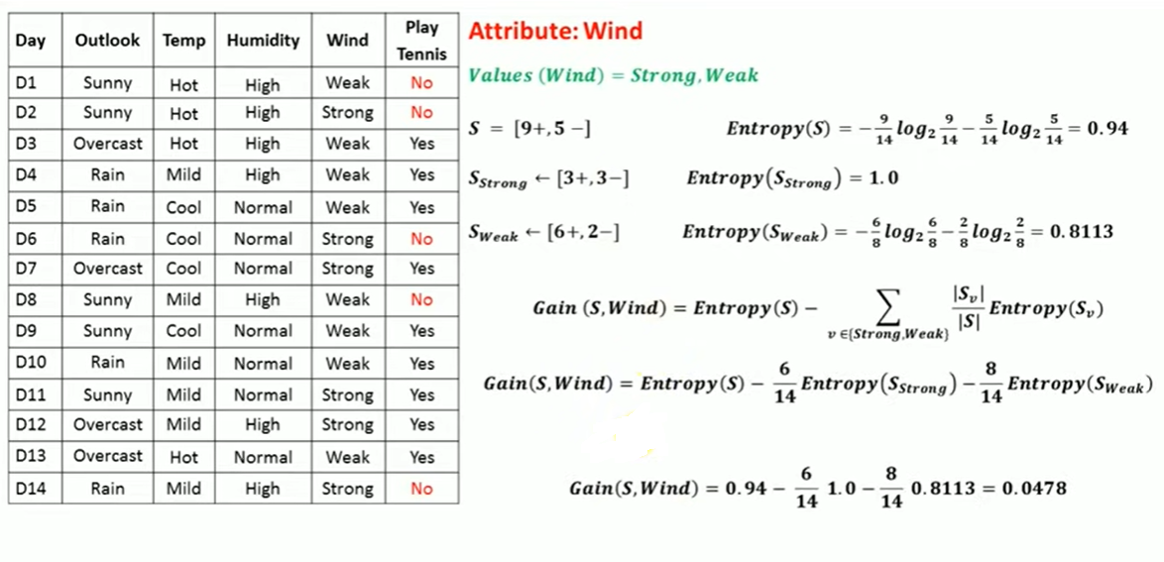

Slide 22
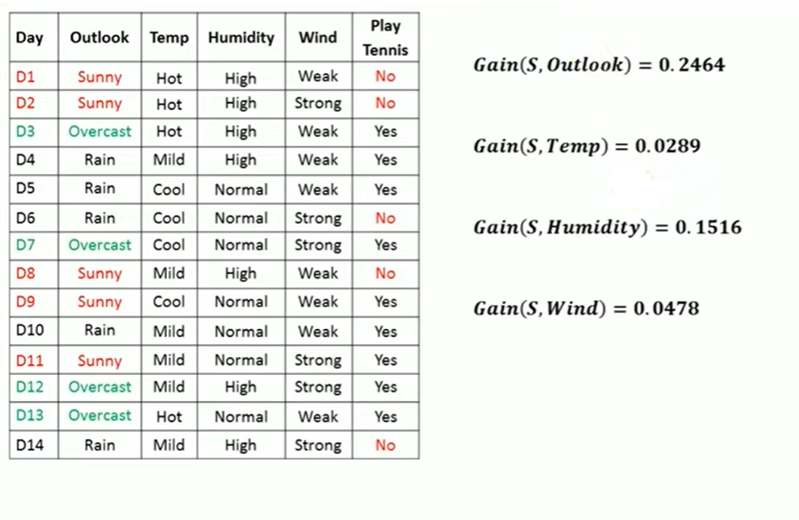

Slide 23
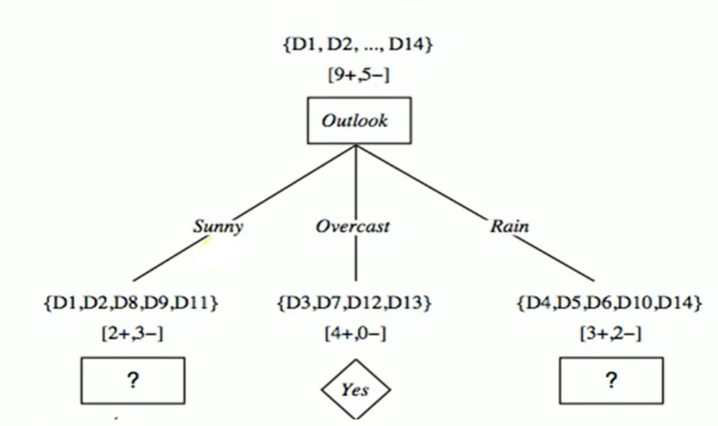

Slide 24
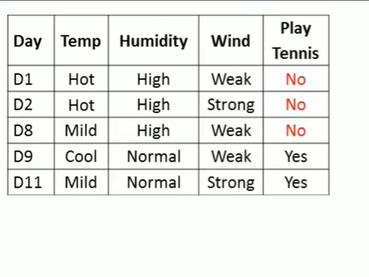
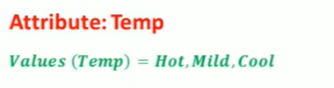

Slide 25
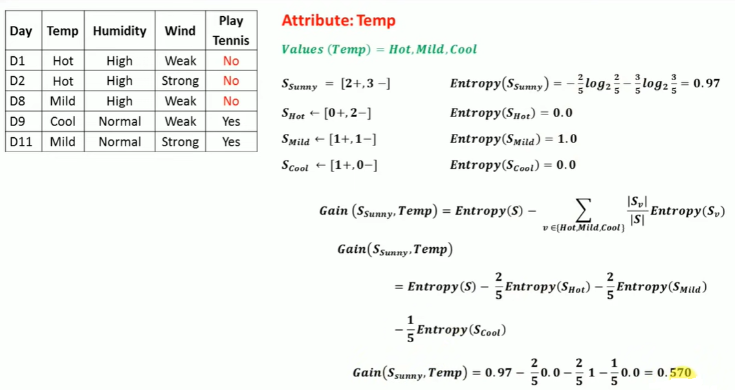

Slide 26
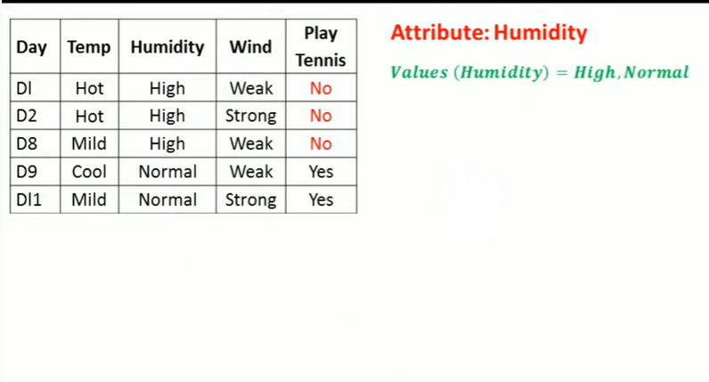

Slide 27
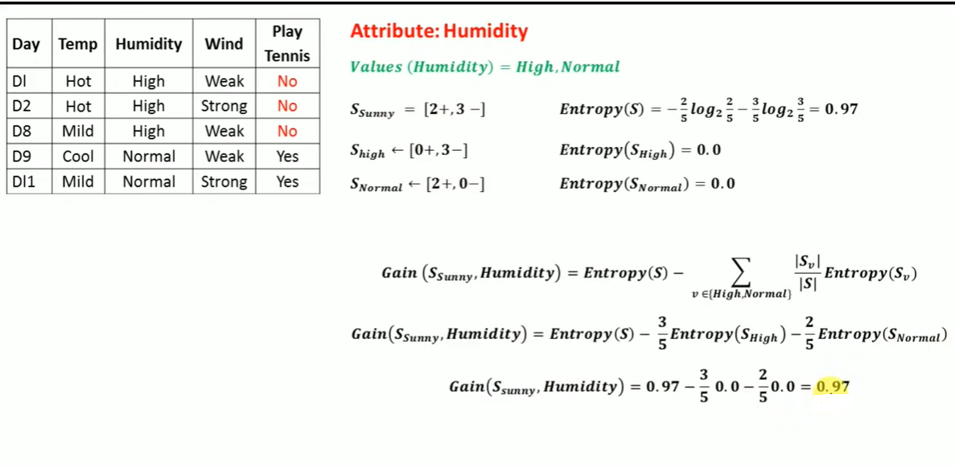

Slide 28
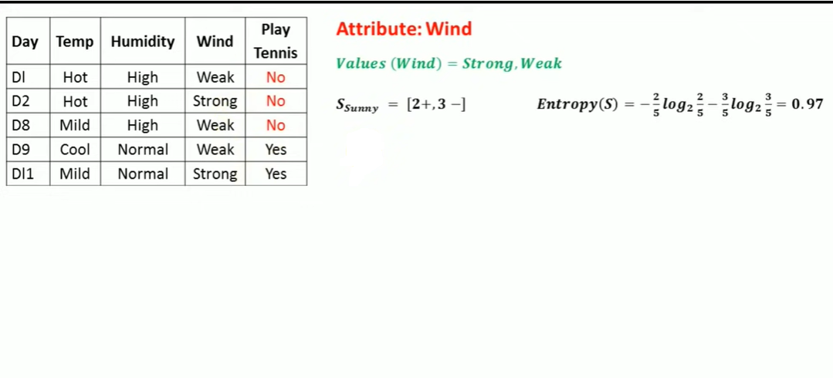

Slide 29
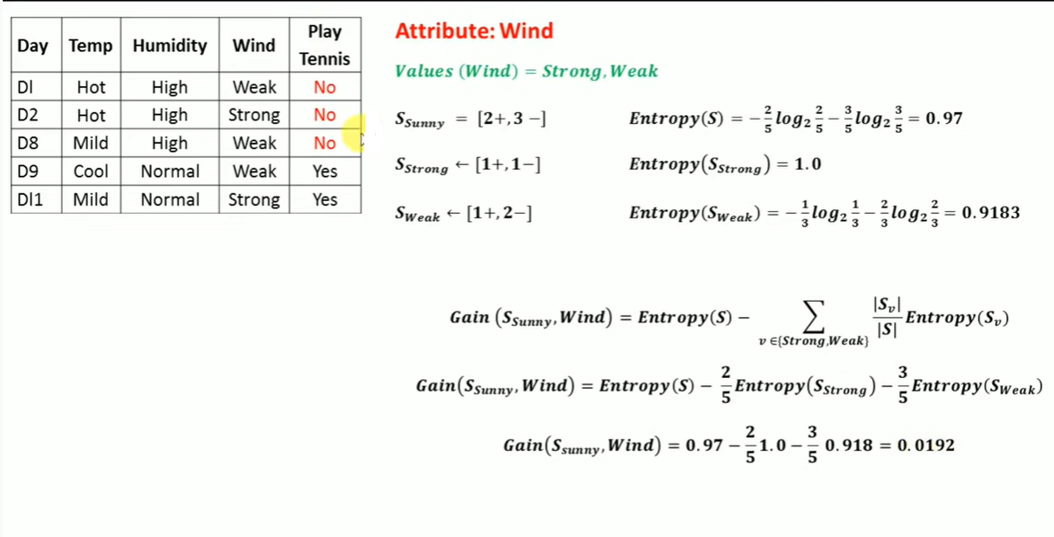

Slide 30
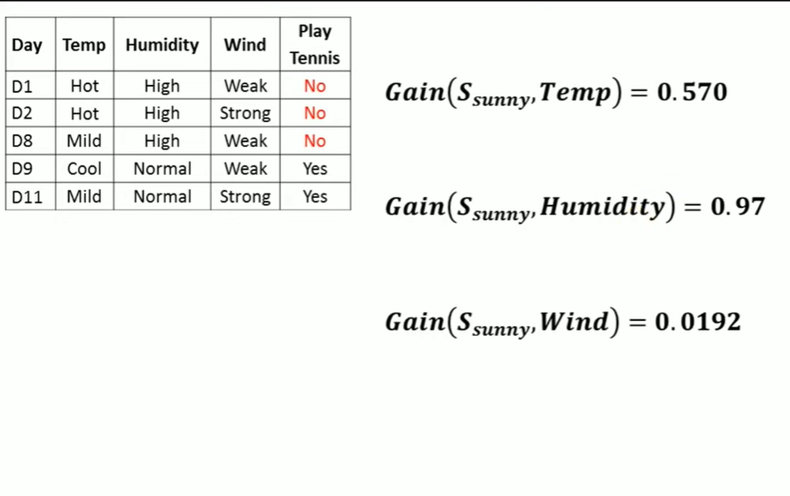

Slide 31
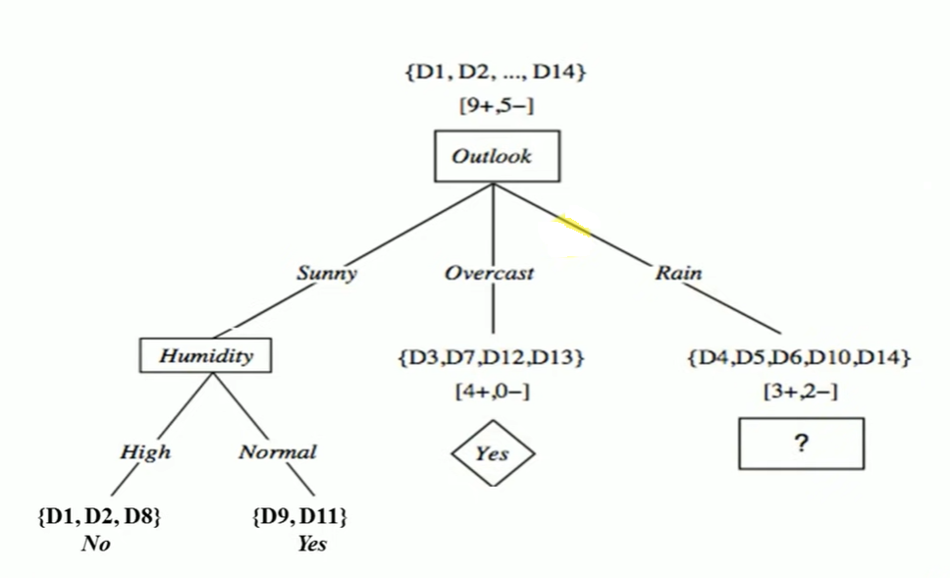

Slide 32
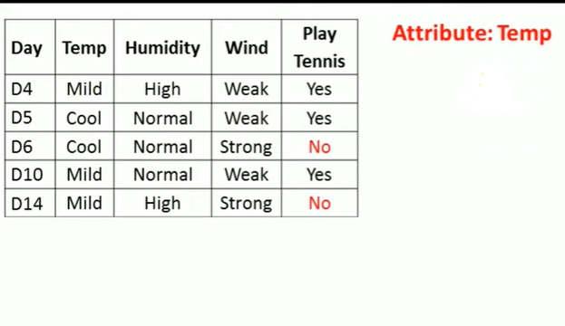
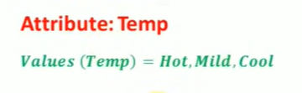

Slide 33
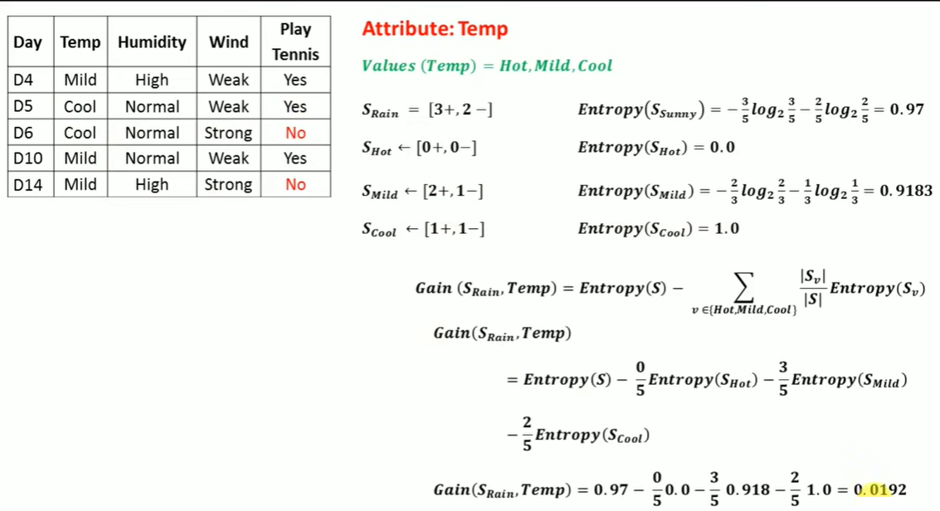

Slide 34
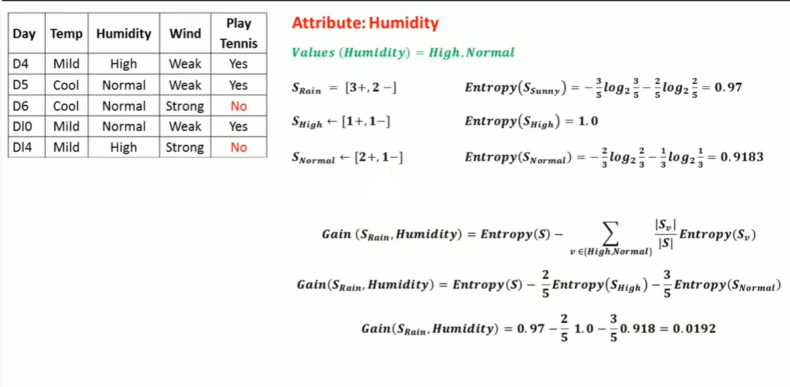

Slide 35
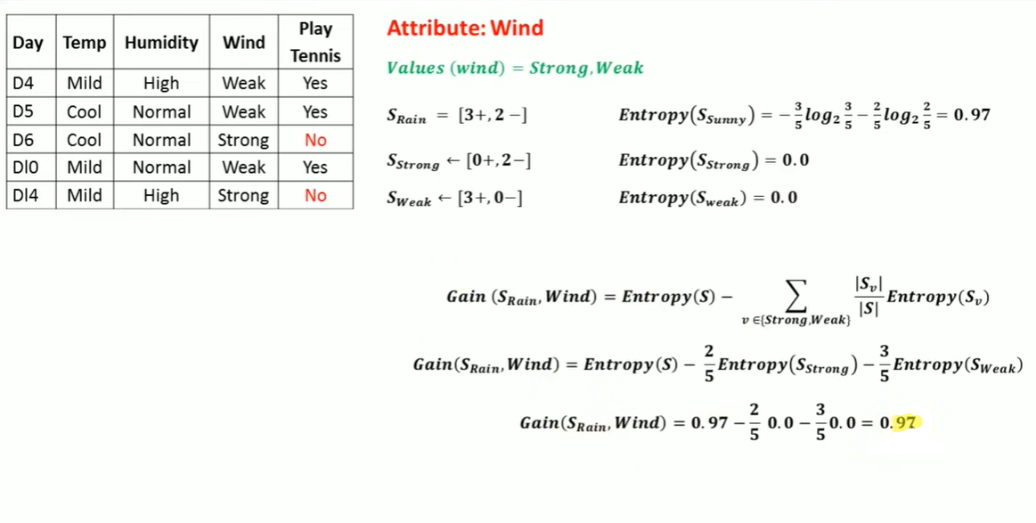

Slide 36
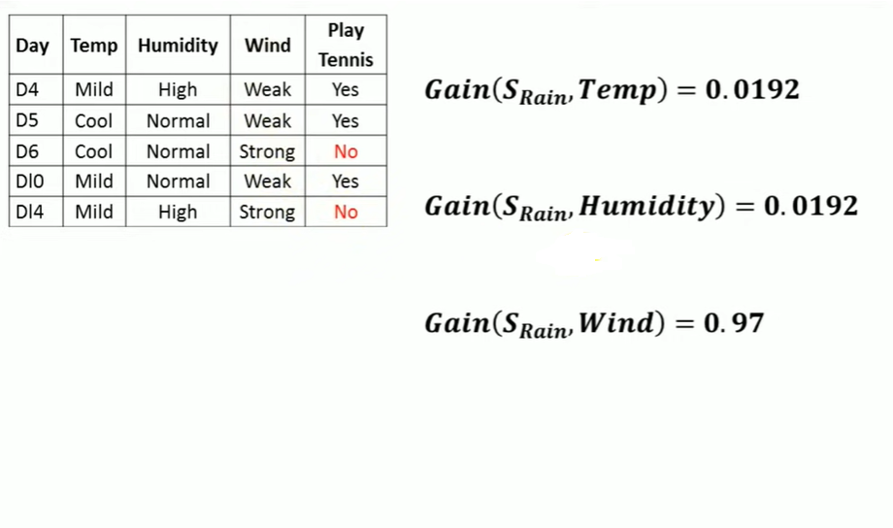

Slide 37
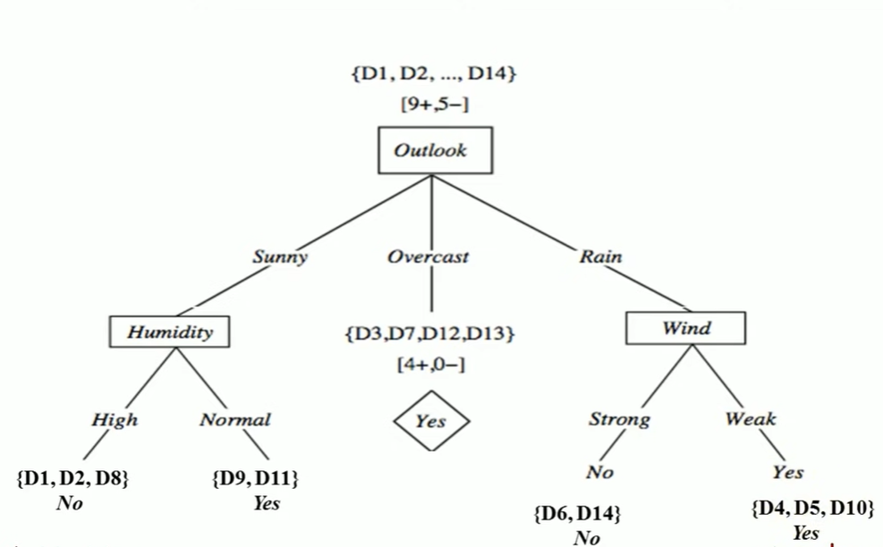

Slide 38
